Slide 1
CS253 – Survey Project Scenario-Based Virtual Testing for Autonomous Vehicles: Methods and Considerations
Huijia Sun, Hongchen Cao
Group0 CS

Slide 2

The train came out of the long tunnel into the snow country. The earth lay white under the night sky. The train pulled up at a signal stop.
— Yasunari Kawabata, Snow Country

Slide 3
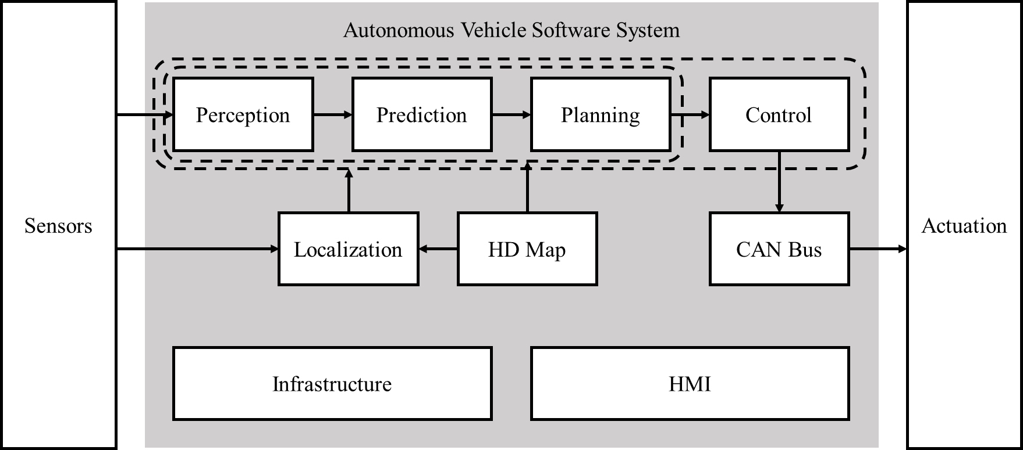
Autonomous Driving System (ADS)
ADS is a decisive factor in determining the AV’s intelligent driving functionality.
Logic-based code + ML-based model

Slide 4
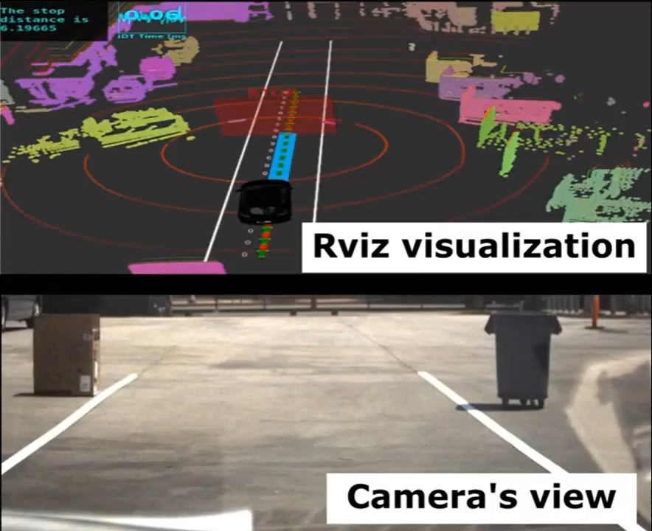
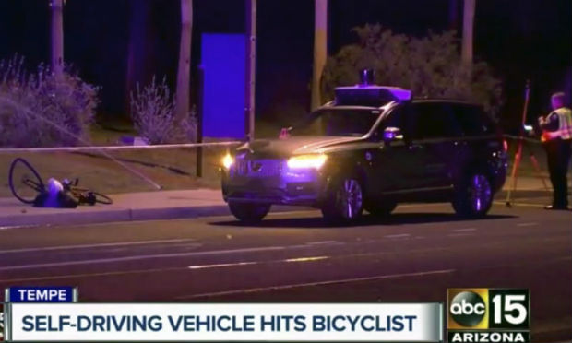

Low-Level Autonomy of AV
AV is highly safety-critical as any slight mistakes made inside it can directly lead to undesirable or fatal outcomes, such as collisions, or permanent stops.
The victim AD vehicle makes stop decision due to the off-the-lane static objects.
Uber self-driving car fatally struck a pedestrian in 2018
A Tesla car in autonomous mode struck a static truck in 2020
Extensive testing is required to ensure AV’s functionality in an unforeseeable number of situations in the real world.

Slide 5
The train came out of the long tunnel into the snow country. The earth lay white under the night sky. The train pulled up at a signal stop.
— Yasunari Kawabata, Snow Country

Slide 6
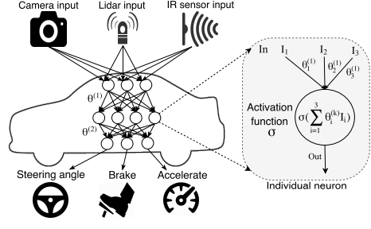
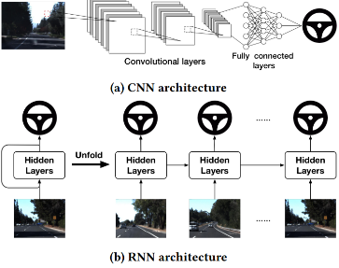
DL-Based Testing-DL in AV
Perception module is the key component of an AV system, which is highly relies on Deep Neural Networks(DNN)

Slide 7
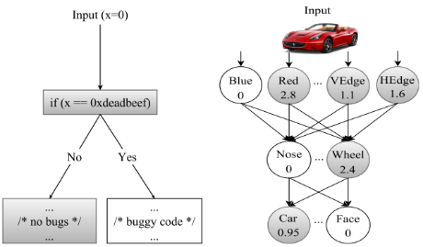
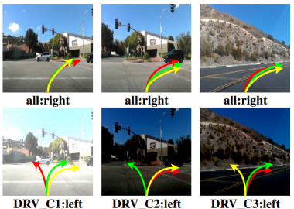
DL-Based Testing
Criteria of Testing Cases
Neuron coverage
Differential behaviors
Challenges for testing DL models
Low test coverage
Need manual labeling/checking

Slide 8
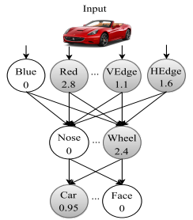
DL-Based Testing-Neuron coverage
What’s neuron coverage?
It is defined as the ratio of the number of unique activated neurons for all test inputs and the total number of neurons in the DNN.
A neuron is considered activated if its output is higher than a threshold value.
How to improve it?
Multi-granularity.
Splitting it into two parts, neuron-level coverage, and layer-level coverage.
…

Slide 9
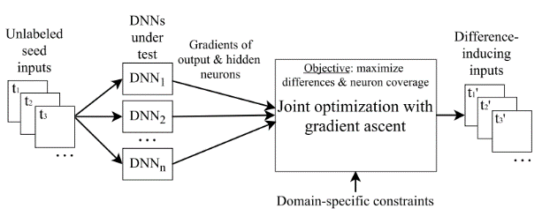
DL-Based Testing-Differential Behaviors
What’s differential behaviors?
DL models with the same function should have the same output for the same input
Maximizing behavioral differences contributes to the generation of input images that are more representative of extreme cases

Slide 10
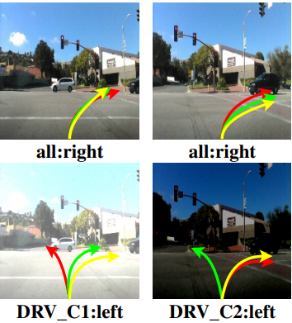
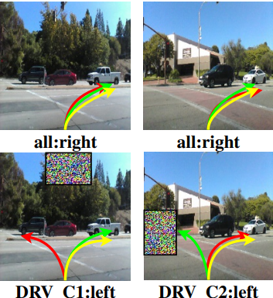
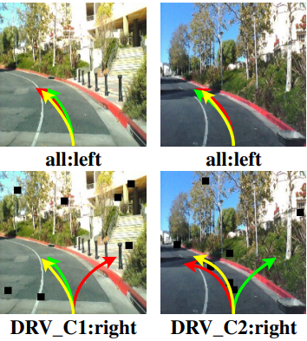
DL-Based Testing-Image Transformation
Image transformation is rule-based and the generated test cases(i.e., input images) can be unrealistic.

Slide 11
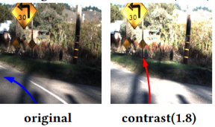
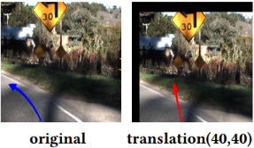
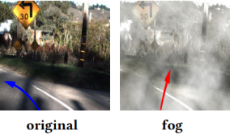
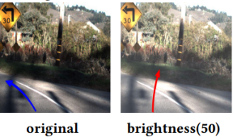
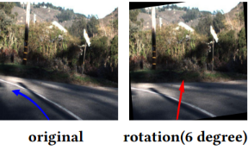
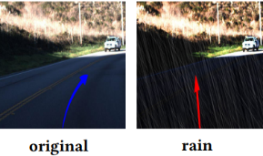
DL-Based Testing-Image Transformation
Image transformation can be improved by using linear, affine, and convolutional transformation matrices
🤔The synthetic images for different scenarios should be realistic.

Slide 12
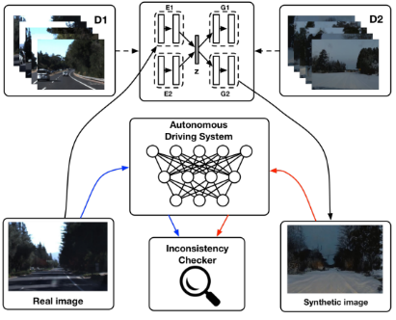

DL-Based Testing-Image Generation
Image generation utilize DL techniques to generate realistic synthetic images

Slide 13
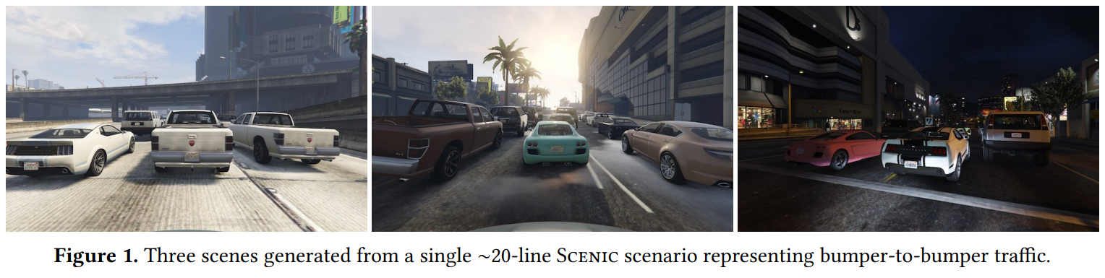
Generating Meaningful Scenarios
What is a scenario?
Scenario is a configuration of objects on a map (e.g., obstacles, vehicles, and pedestrians) as well as their dynamic behavior.
How to generate meaningful scenarios?
Scenario space is large
Generating realistic scenarios requires complex geometric constraints
Need a formal model of the environment
How to encode: a Domain-Specific Language!

Slide 14
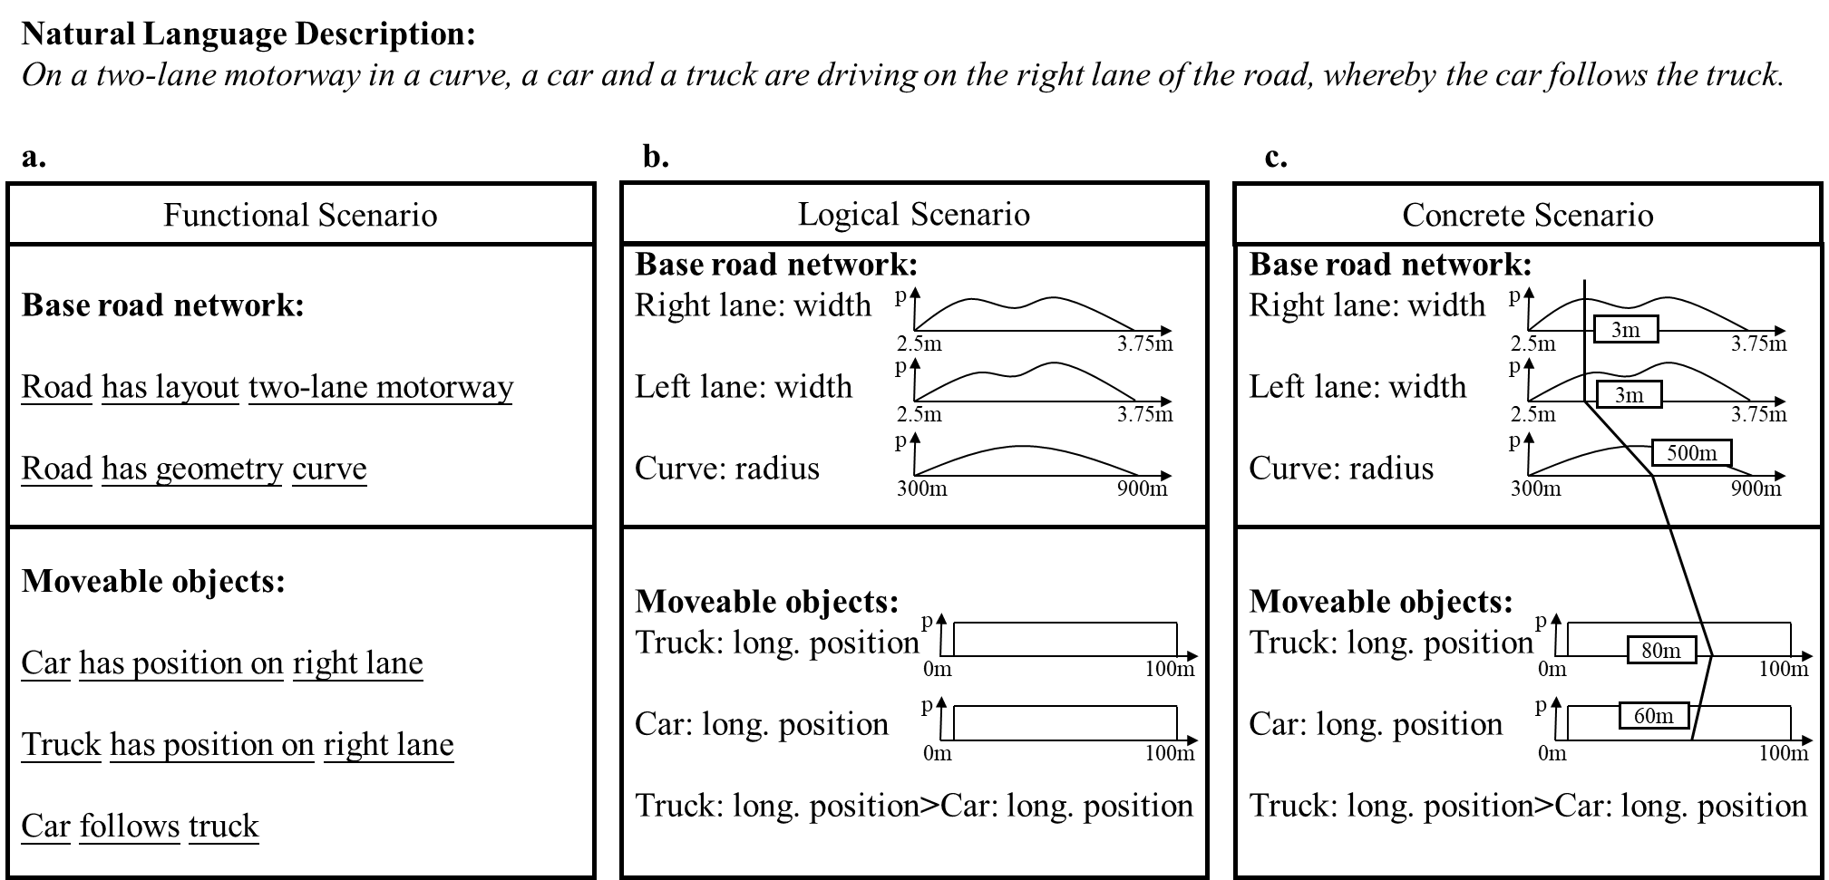
Scenarios for Scenario-Based Testing

Slide 15
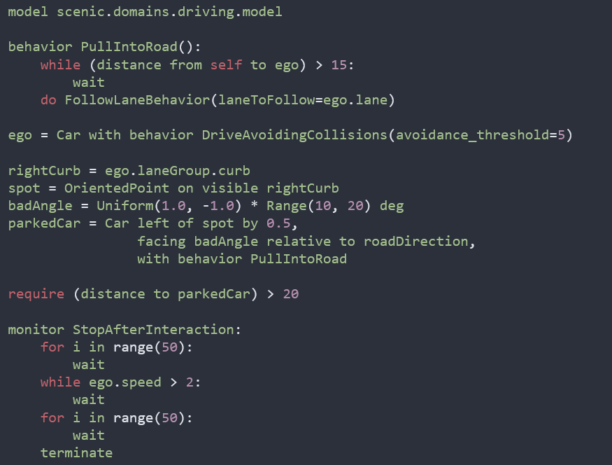
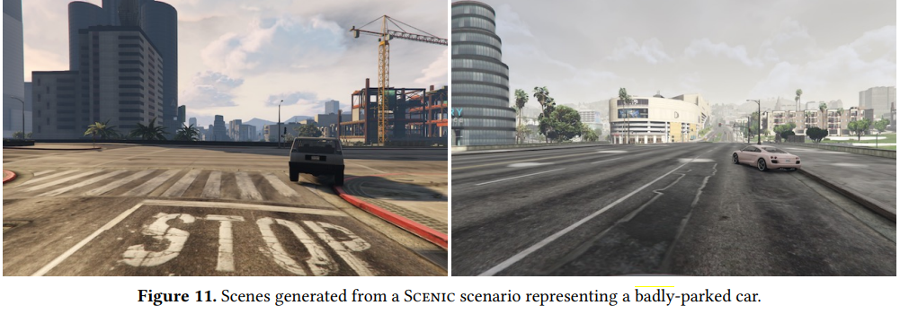
Scenarios for Scenario-Based Testing
SCENIC
An imperative, object-oriented Probabilistic Programming Language (PPL) defining distributions over scenarios
Readable, concise syntax for common geometric relationships
Domain-specific sampling techniques based on configuration spaces
Declarative hard and soft constraints

Slide 16
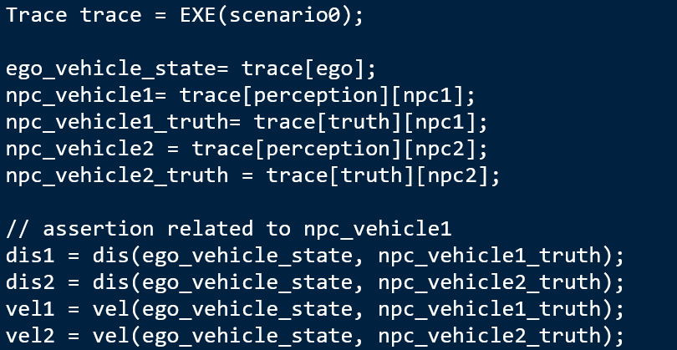
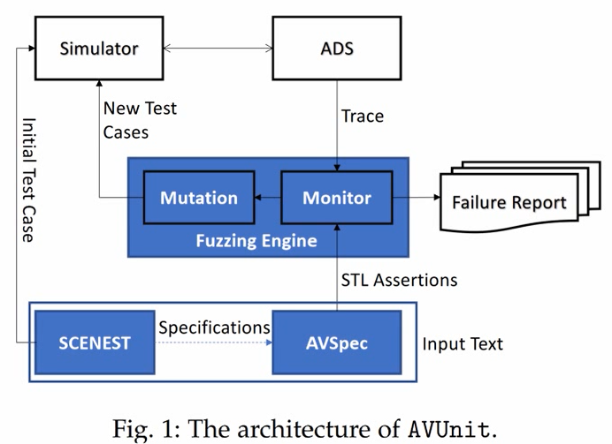
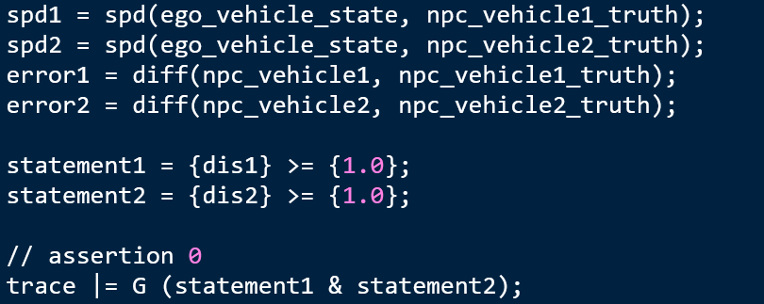
Scenarios for Scenario-Based Testing
AVUnit
A high-level descriptive language designed for descripting scenes and scenarios to test AVs
Multiple algorithms for automatically generating test cases accordingly to descripted scenarios and assertions

Slide 17
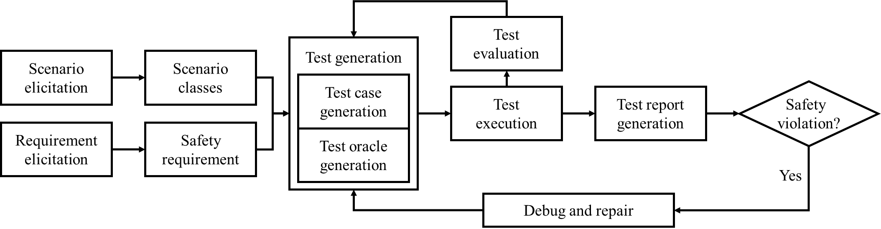
How to Test: Workflow
Test case generation and test oracle identification are key activities involved in scenario-based AV virtual testing

Slide 18
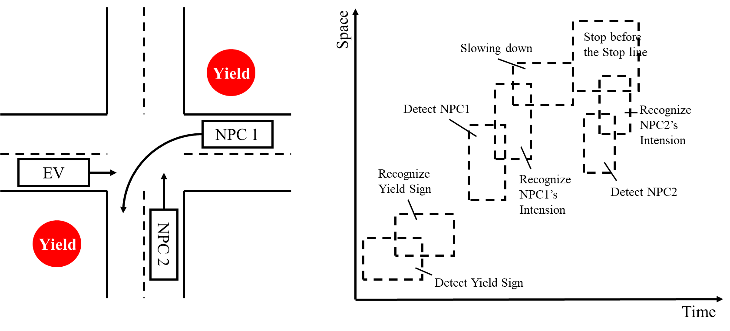
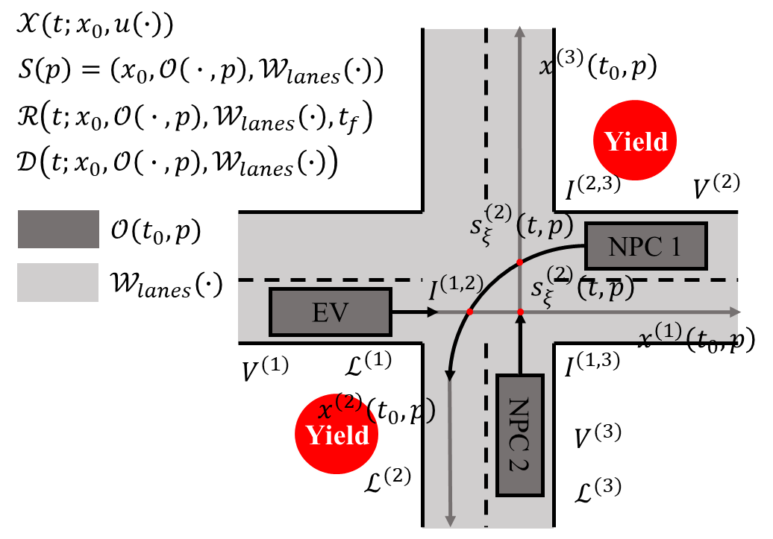
Test Case Generation
Modeling the Scenarios
Defining Criticality Measures
Obtaining Target Scenarios
Modeling the Scenarios
Modeling from a global perspective
Modeling from EV’s perspective
🤔Discretization suffers from the risk of missing valuable test cases.

Slide 19
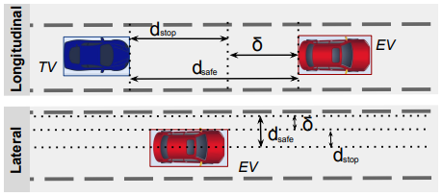
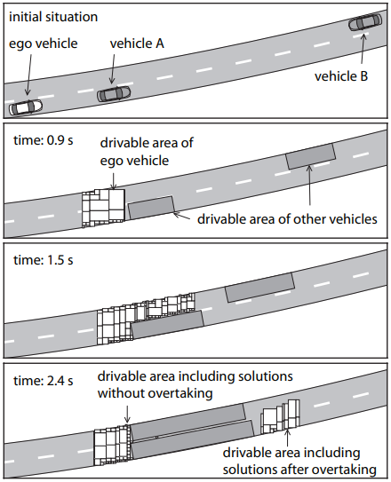
Test Case Generation
Modeling the Scenarios
Defining Criticality Measures
Obtaining Target Scenarios
Defining Criticality Measures
Distance
Drivable Area
Velocity, Acceleration, or Jerk
🤔Safety requirements are quantitative and measurable in the testing processes.

Slide 20
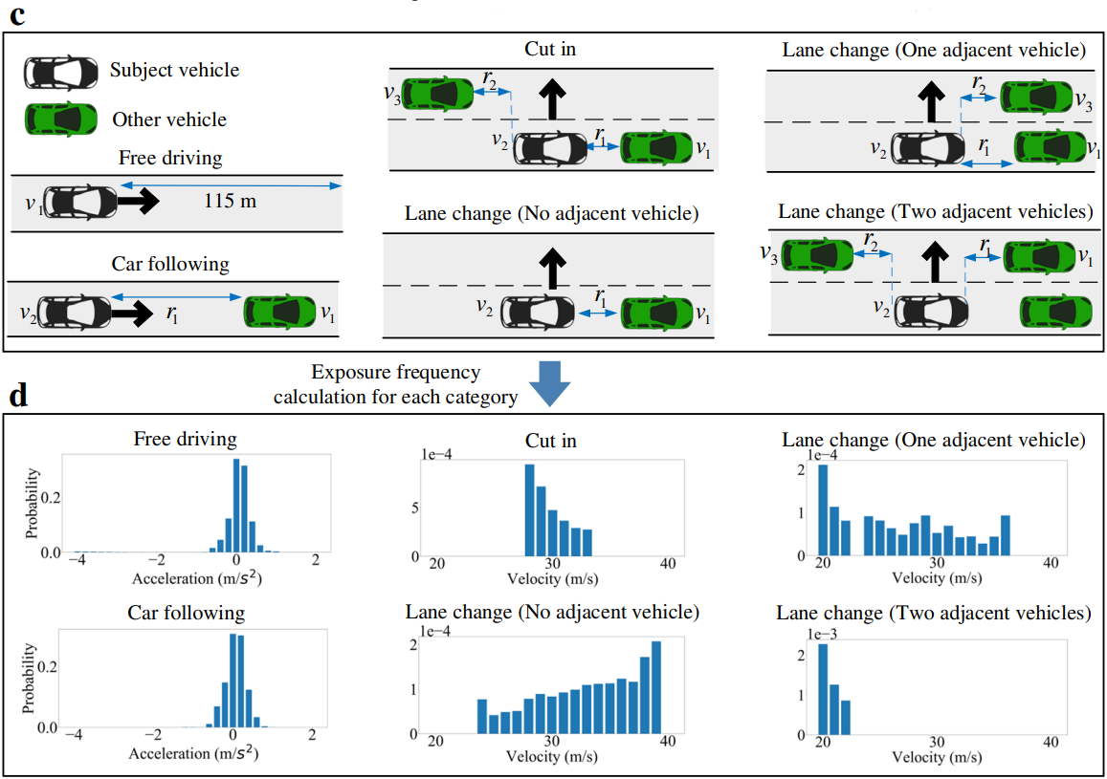
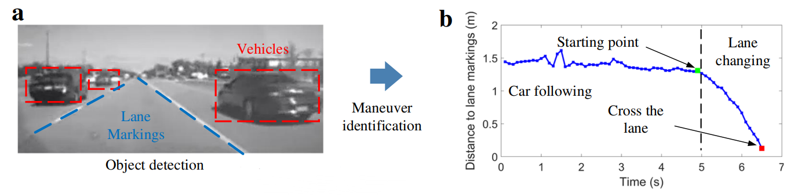
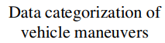

Test Case Generation
Modeling the Scenarios
Defining Criticality Measures
Obtaining Target Scenarios
Modeling the Scenarios
Modeling using statistical models
🤔In data-driven approaches, the datasets used should be representative, and the probability distributions need to be valid.

Slide 21
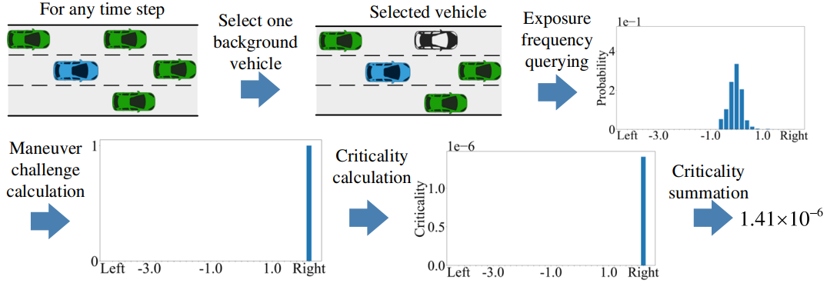
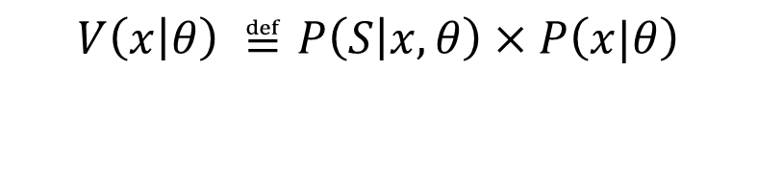
Test Case Generation
Modeling the Scenarios
Defining Criticality Measures
Obtaining Target Scenarios
Defining Criticality Measures
Joint Probability
$$V\left(x | θ\right) ≝P\left(S | x, θ\right)×P\left(x|θ\right)$$
Maneuver challenge
Exposure frequency

Slide 22
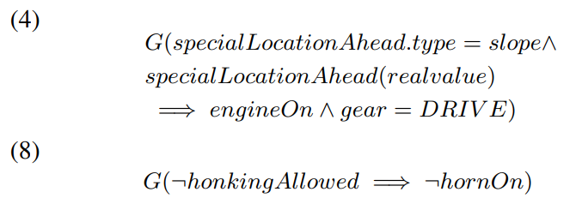
Test Case Generation
Modeling the Scenarios
Defining Criticality Measures
Obtaining Target Scenarios
Modeling the Scenarios
Modeling using STL technique
Original Safety Requirements:
A tram should stop within 3 seconds when a pedestrian is on the crossing.
The Original Rule:
Driving a motor vehicle shall not have the following behaviors:
Turn off the engine or slide in neutral when descending a steep slope;
Honk horns in areas or road sections where honking is prohibited.

Slide 23
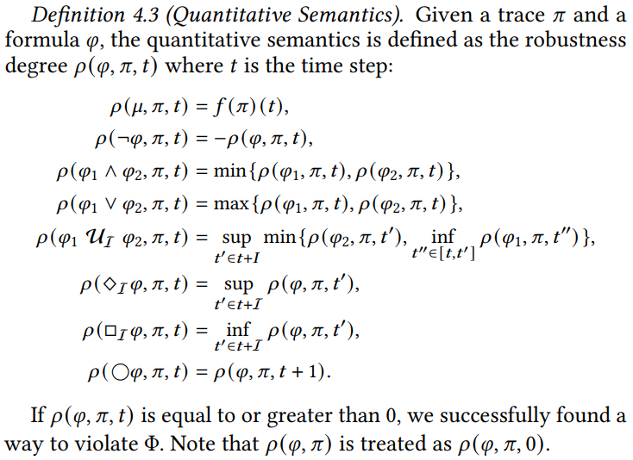
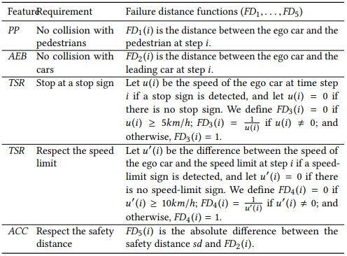
Test Case Generation
Modeling the Scenarios
Defining Criticality Measures
Obtaining Target Scenarios
Defining Criticality Measures
Degree of Violation
🤔Adopted criticality measures should be valid. What’s more, Proper thresholds for criticality measures are applied.

Slide 24
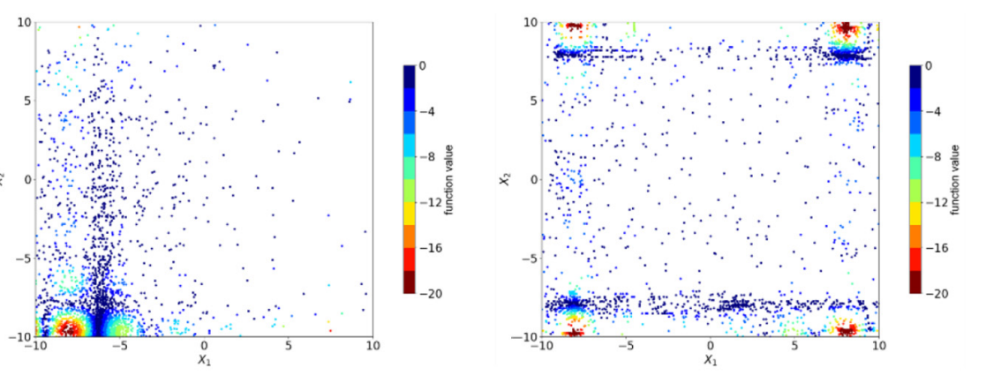
Test Case Generation
Modeling the Scenarios
Defining Criticality Measures
Obtaining Target Scenarios
Obtaining Target Measures
Using Search-Based Algorithms
Evolutionary Algorithm (EA)
Differential Evolution (DE)
Particle Swarm Optimization (PSO)
……
Repair/Auxiliary Algorithm
Samples distribution of algorithms
🤔The critical subspace needs to be explored systematically.

Slide 25
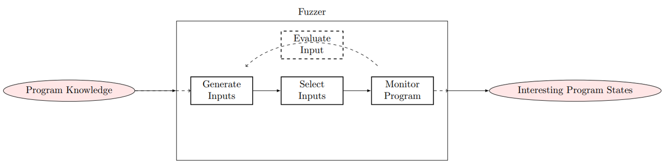
Test Case Generation
Modeling the Scenarios
Defining Criticality Measures
Obtaining Target Scenarios
Obtaining Target Measures
Using GA-based Fuzzing
Fuzzing is the execution of the program under test using input(s) sampled from an input space that protrudes the expected input space of the program under test.

Slide 26
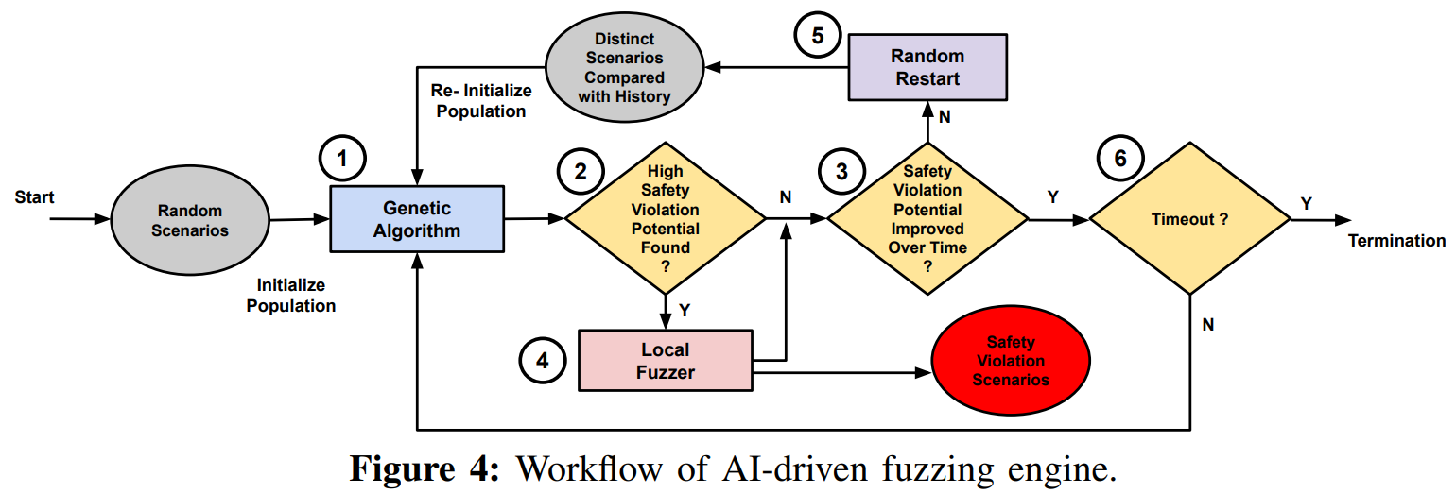
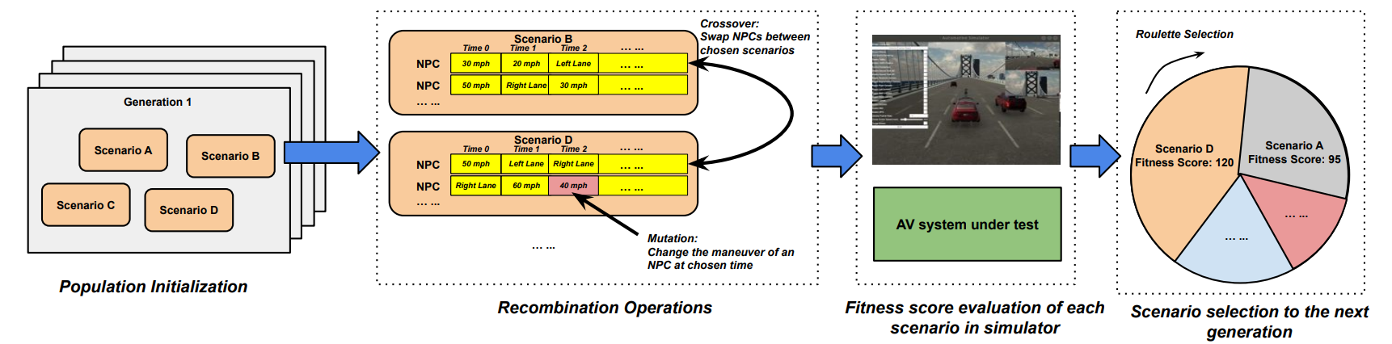
Test Case Generation
Modeling the Scenarios
Defining Criticality Measures
Obtaining Target Scenarios
Obtaining Target Measures
Using GA-based Fuzzing
Genetic Algorithm:
Start with population
Driven by a fitness function
Recombination operations

Slide 27
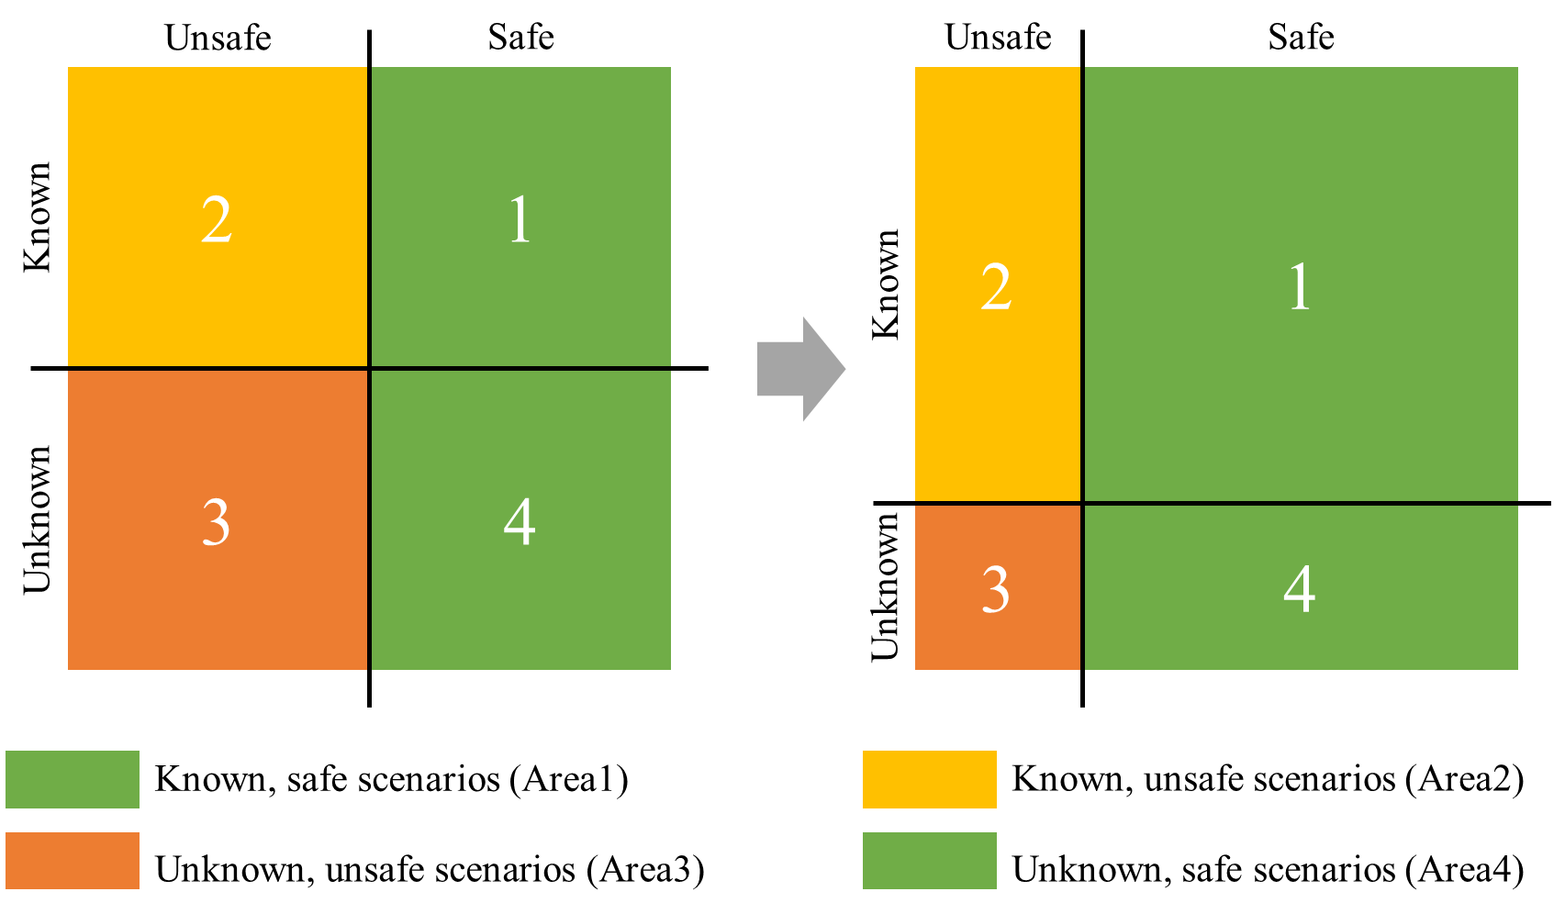
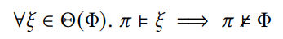
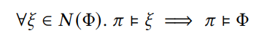
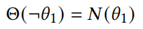
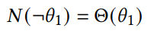
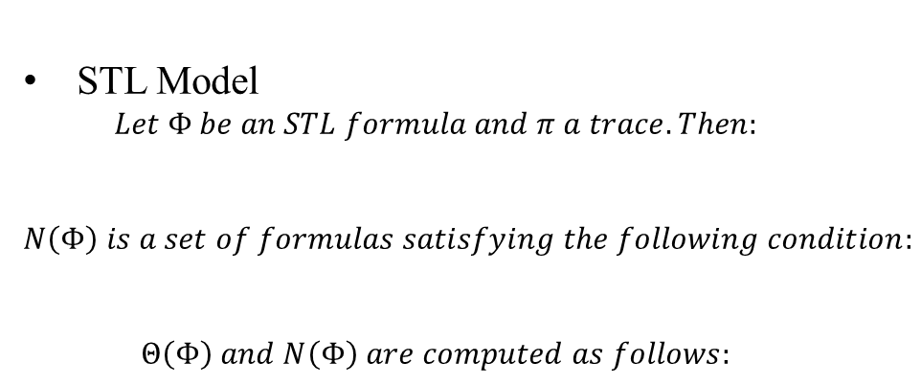
Test Case Generation
Improving Testing Coverage
Confusion Matrix
STL Model
$$Let Φ be an STL formula and π a trace. Then:$$
$$N\left(Φ\right) is a set of formulas satisfying the following condition:$$
$$Θ\left(Φ\right) and N\left(Φ\right) are computed as follows:$$

Slide 28
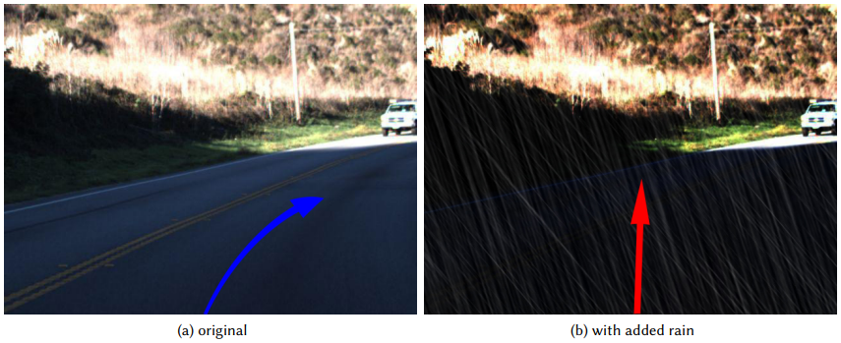
Test Oracle Generation
Statistical Measurements as Test Oracles
Criticality Measures
Distance
Drivable Area
Velocity, Acceleration, or Jerk
Joint Probability
Degree of Violation
……
Metamorphic Relations as Test Oracles
A relationship between the input and the output holding among multiple executions
Check the functionality of the software under test

Slide 29




Trends & Opportunities
Trends
Publication year
Venue
High-frequency vocabulary
Opportunities
Test Oracle for Scenario-Based AV Testing
Test Adequacy for Scenario-Based AV Testing
Fault Localization

Slide 30




Open-Source ADSs and Related Tools
Open-Source ADSs
Apollo
Autoware
Simulators
LGSVL (out of maintenance)
CARLA

Slide 31
Thank You for Listening!

